Slide 1
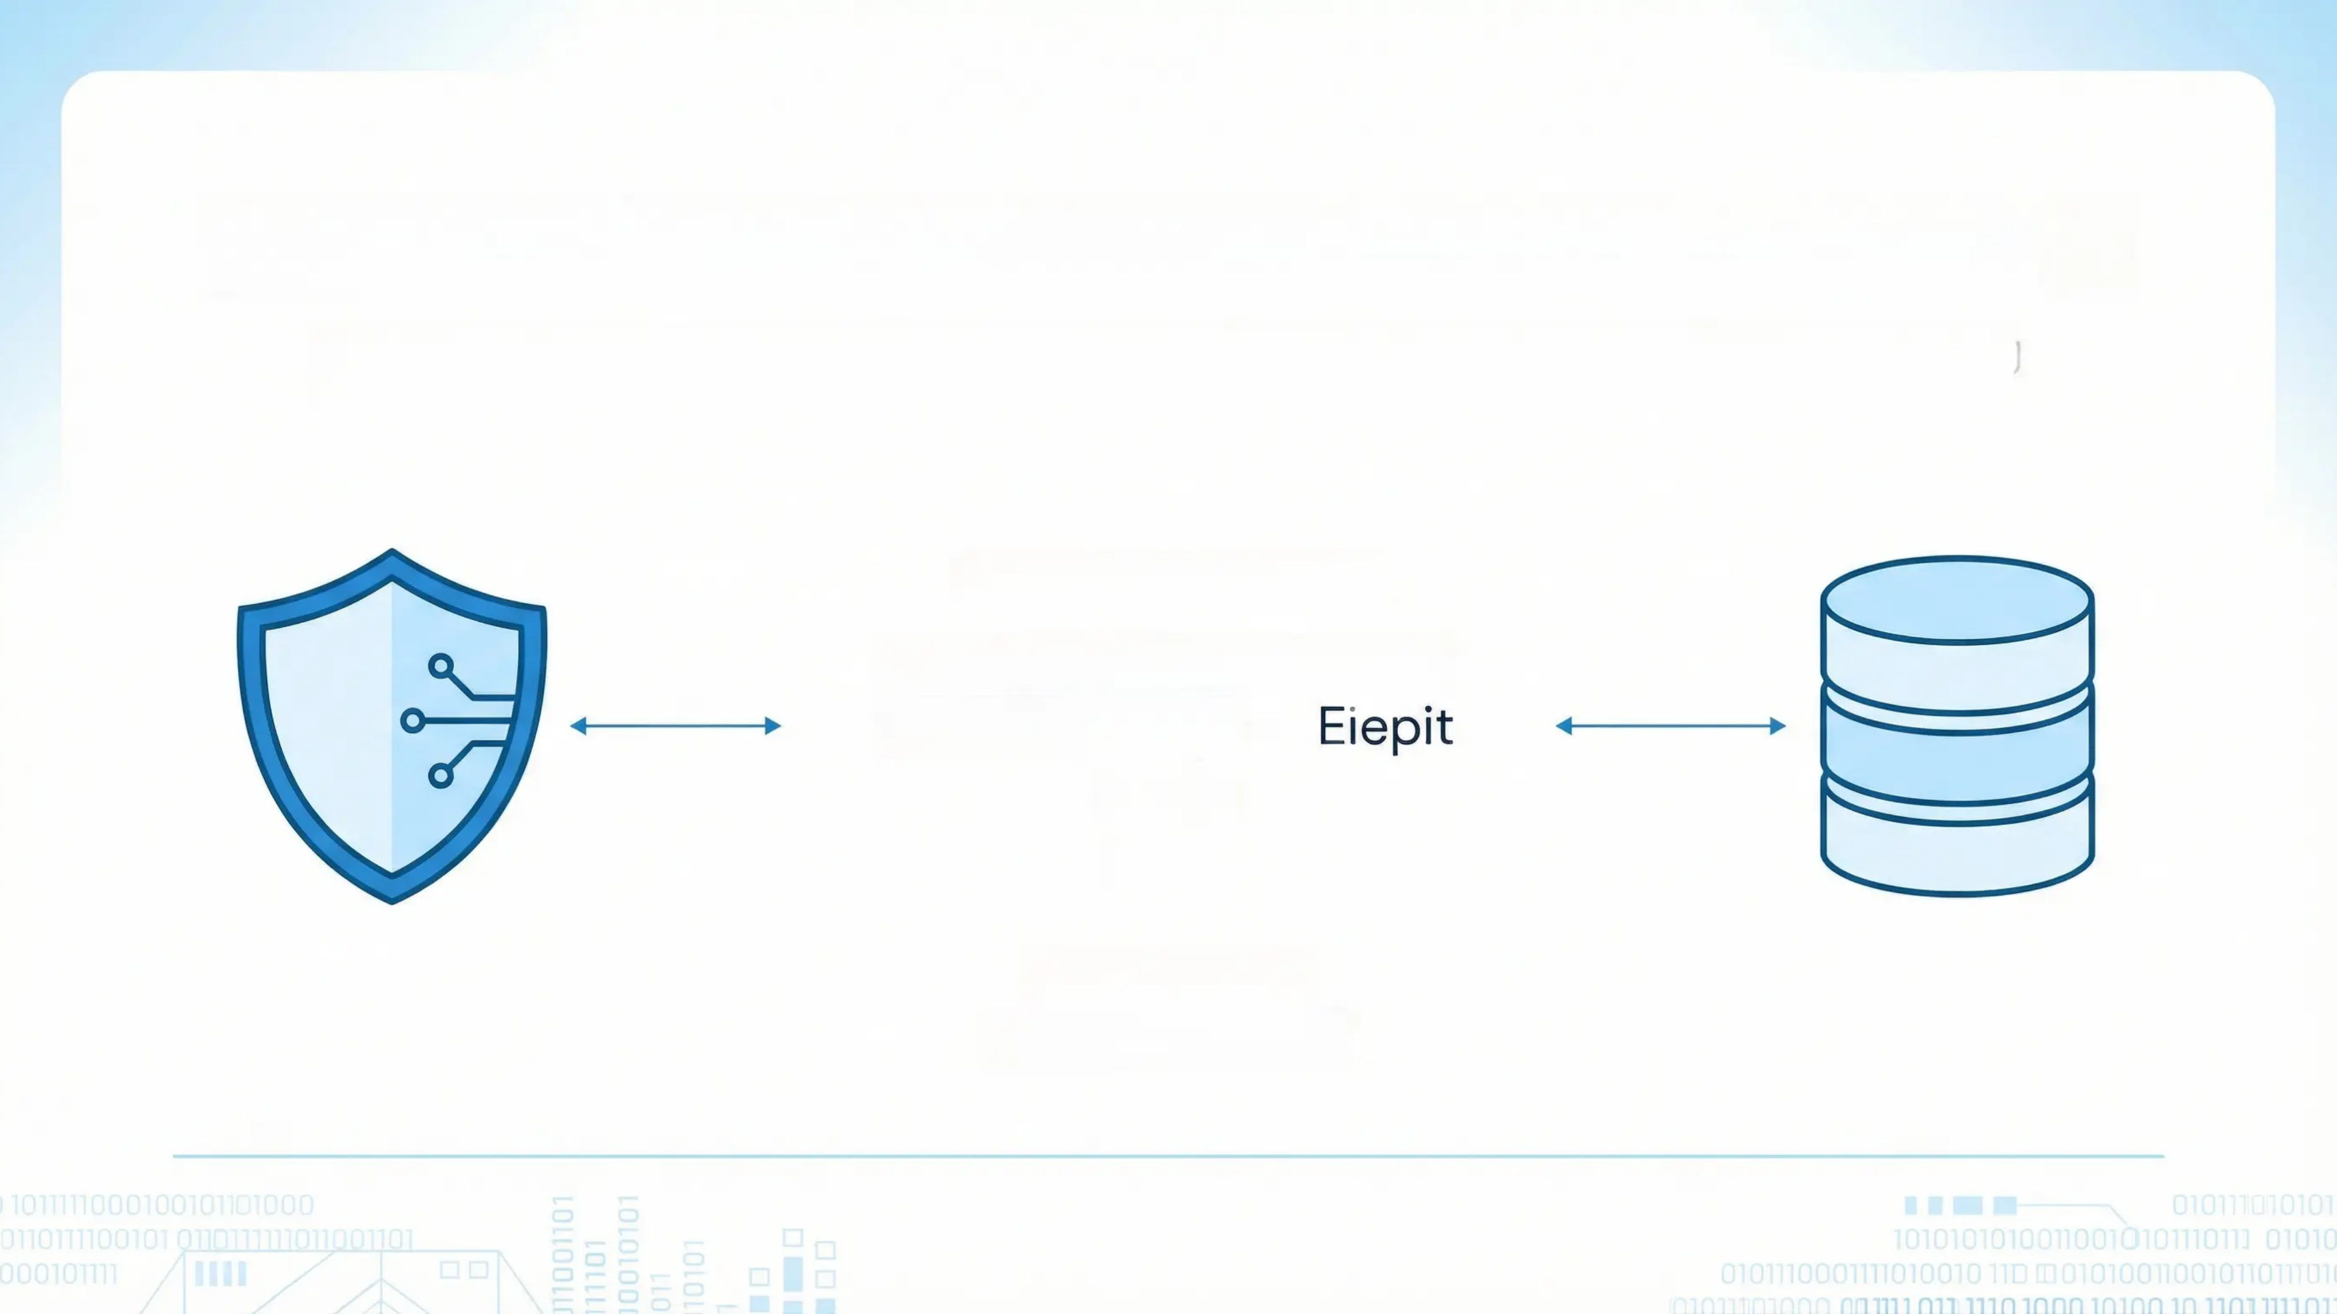
Transaction-Safe Bank Account System
Foundations of Programming Mini Project 2025-26
Team Members: 1. Nitin (PRN: 1262251825)
2. Kartik (PRN: 1262253310)
3. Aditya (PRN: 1262253439) 4. Kavya (PRN: 1262253592) 5. Arpit (PRN: 1262251891) Guided by:
Dr. Anushri Kulkarni

Slide 2



Introduction and Motivation
Implements a banking system with crash recovery
Ensures safe money transactions using rollback mechanism
Prevents database corruption during failures
Demonstrates real-world database safety concepts

Slide 3



Problem Statement and Objectives
Problem Statement:
• Prevent data loss during transaction failure or crash
Objectives:
• Maintain consistent account database • Provide deposit, withdraw, and transfer operations • Implement backup, restore, and atomic commit system

Slide 4


Individual Contribution
Nitin – PPT design, presentation and result analysis
Kartik – Deposit, withdraw, transfer implementation, presentation
Aditya – Program structure, Roll back mechanism and presentation
Kavya – Documentation, report writing, formatting and presentation
Arpit – Testing, debugging, crash recovery validation and presentation

Slide 5




Literature Survey
ACID Properties in Database Systems
File-based transaction recovery techniques
Atomic file replacement using rename()
Binary file storage for performance and safety

Slide 6

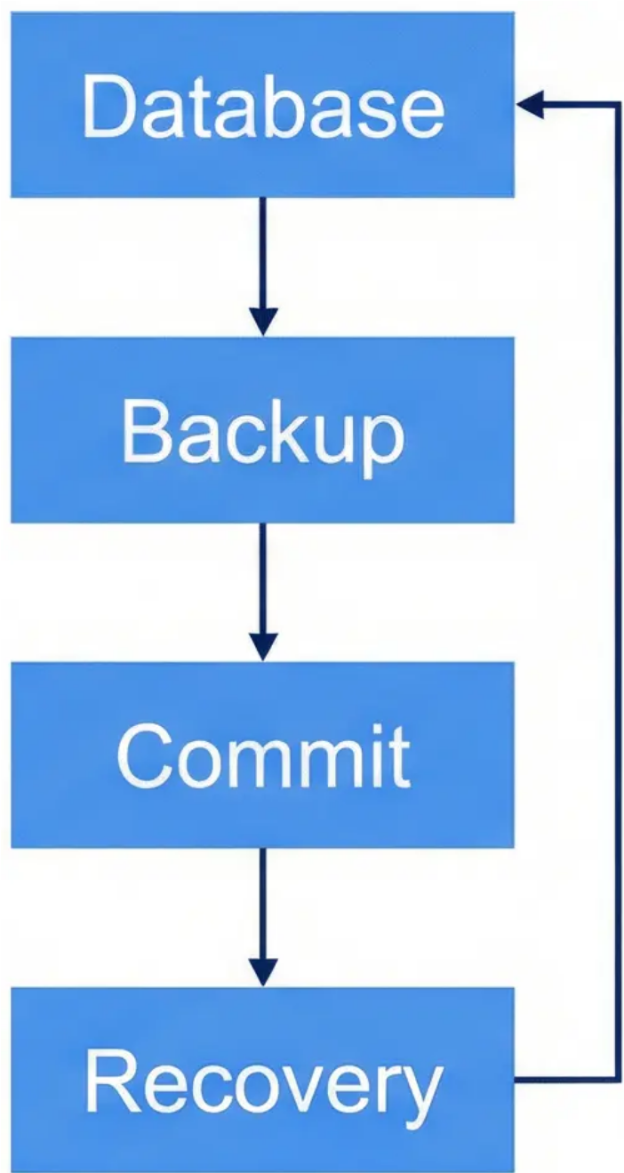

Proposed System
• Binary file-based banking database
• Undo backup before each transaction
• Temporary file commit mechanism
• Automatic crash detection and recovery

Slide 7



Hardware and Software Requirements
Hardware:
Software:
Standard PC/Laptop
C Compiler (GCC / Turbo C)
RAM: Minimum 4 GB
Operating System: Windows / Linux

Slide 8


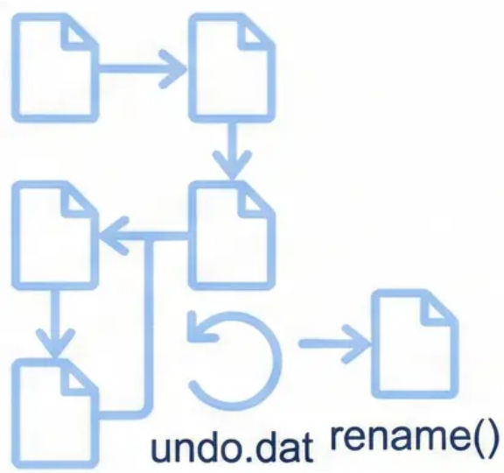
Implementation and Experimental Setup
• Language: C Programming
• Binary file handling using fread/fwrite
• Rollback using undo.dat backup file
• Atomic commit using rename()

Slide 9



Results
Transactions safely committed or rolled back
Database remains consistent after crash
Demonstrates real banking safety principles
Useful learning of file systems and recovery

Slide 10


Conclusion
Ensures atomic transactions through robust rollback mechanisms
Provides valuable learning foundation for database recovery concepts
Demonstrates strong principles applicable to real banking systems
A comprehensive foundation for understanding transaction safety in banking applications

Slide 11



References
1. Database System Concepts – Silberschatz
2. Operating System File Handling Concepts
3. C Programming File I/O Documentation
Thank You

